Slide 1
Introduction to Operations Research
SYE 1010
Dr. MD Sarder

Slide 2
Production Scheduling (PS) Problem
What is PS problem?
Product production scheduling is the process of assigning different raw materials, resources or processes to different products. It's meant to make your production process as efficient and cost-effective as possible when it comes to materials and people — all while delivering products on time.
What is the importance of PS?
  Production scheduling is essential to the entire supply chain. In fact, it’s responsible for some of the most important key performance indicators (KPIs) in the supply chain as a whole.

Slide 3
PS Problem
PS Goals?
Here are a few common production scheduling KPIs:
  Daily performance
  Cost reduction
  Production service rate
  Inventory turn
  Production time
  Cycle time
  Order management
With the above KPIs in mind, we’ll need to come up with a reasonable timeframe and map out how we’ll reach our goals.

Slide 4
PS Problem
Techniques of PS Optimization
Identifying priority: The one that should be obvious from any schedule optimization definitions.
Assessing the to-do list: To make sure that your tasks align with your purpose or not, you need to assess and judge the actions of your to-do list.
Formulating actions: You don’t have to plan everything to the perfect point. But every good job starts with a good plan. So you should aim to formulate one that aligns most with your purpose.
Reassessing plans: Not everything will be perfect on the first go. You may slip up things here and there. Also, you can miss out on important steps or actions or find a better way to do things. So it is very important to reassess your plans continuously even if they are seemingly perfect at a glance.
Executing: An average plan in action is better than a perfect plan on paper. So make sure to follow up with the plans and send them out to your employees or peers and follow the adjustments accordingly.

Slide 5
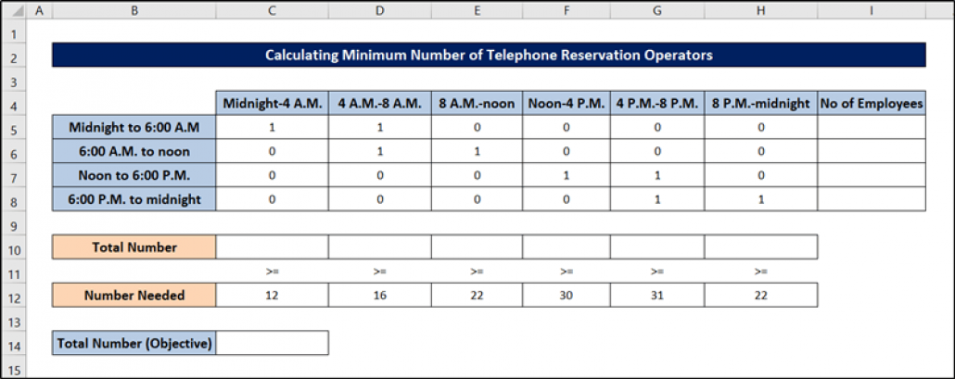
Production Scheduling (PS) Example # II
Table shows the number of telephone reservation operators needed by an airline during each time of day. Each operator works one of the following six-hour shifts: midnight to 6:00 A.M, 6:00 A.M. to noon, noon to 6:00 P.M., and 6:00 P.M. to midnight. The minimum number of operators needed is shown in the range C12:H12. What is the min number of operators need to Meet Labor Demands?

Slide 6
Production Scheduling (PS) Example # II
Objective: Minimize the total number of employees
Changing cells: The number of employees who work each of that six-hour shift.
Explicit Constraints: For each time of day, the number of employees who are working must be greater than or equal to the number of employees required
Implicit Constraints: Each changing cell must be a non-negative integer
The range C5:H8 is used to track if employees work or not. 1 means that the employee will work on that day while 0 indicates that the employee will not work on that day. For example, 1 in C5:D5 means that employees start working on midnight through 8 A.M.

Slide 7
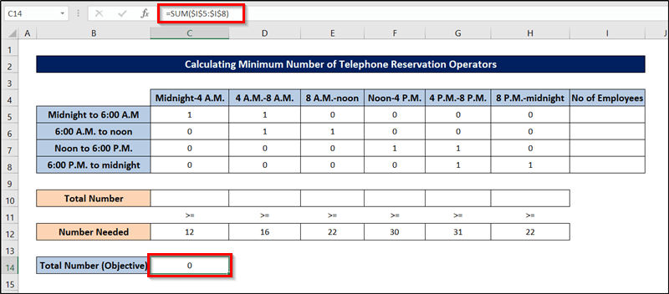
PS Example I Solver Step-1

Slide 8
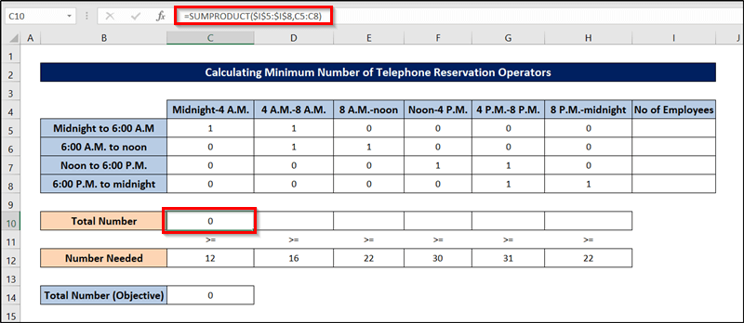
PS Example I Solver Step-2

Slide 9
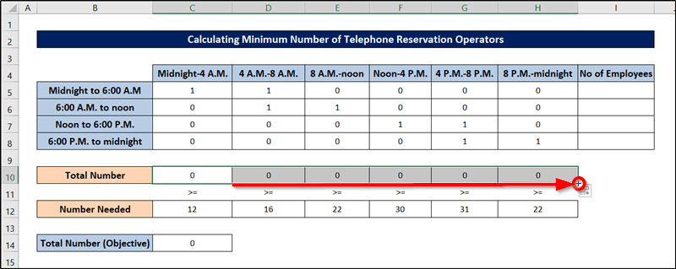
PS Example I Solver Step-3

Slide 10
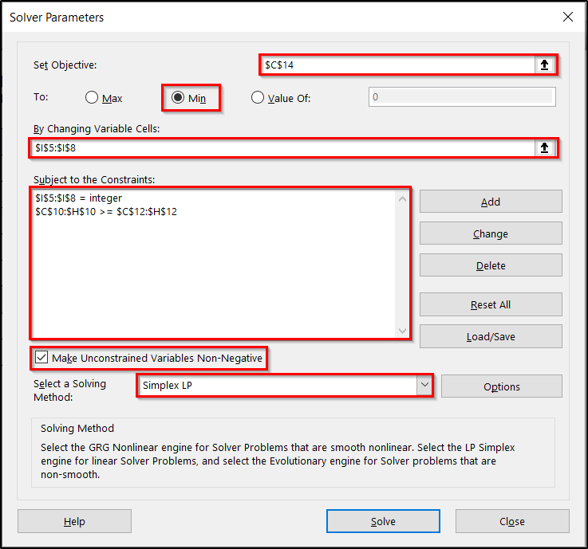
PS Example I Solver Step-last

Slide 11
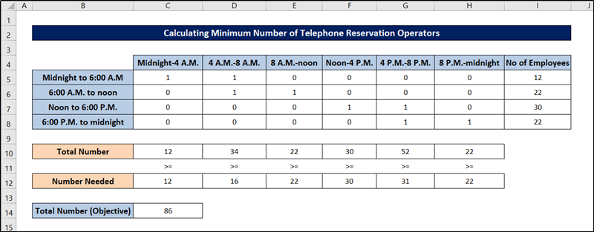
PS Example I Optimal Solution

Slide 12
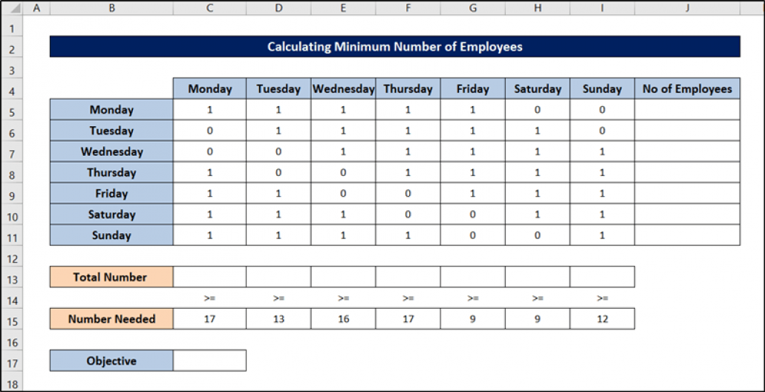
Production Scheduling (PS) Example # II
Table shows the number of workers needed for a bank is shown in cells from C15 through I15. For example, 17 workers are needed on Monday, 13 workers are needed on Tuesday, 15 workers are needed on Wednesday, and so on. All bank employees work five consecutive days. What is the minimum number of employees that this bank can have to meet its labor requirement?

Slide 13
Production Scheduling (PS) Example # II
Look at the figure again. Numbers of employees who start work (the first of five consecutive days) each day of the week will be recorded in the range J5:J11. Our objective – the total number of employees – is put into cell C17. The range C5:I11 is used to track if employees work or not. 1 means that the employee will work on that weekday while 0 indicates that the employee will not work on that day. For example, 1 in C5:G5 means that employees start working on Monday and work Monday through Friday. We have prepared the sheet by the usage of the SUM and SUMPRODUCT functions

Slide 14
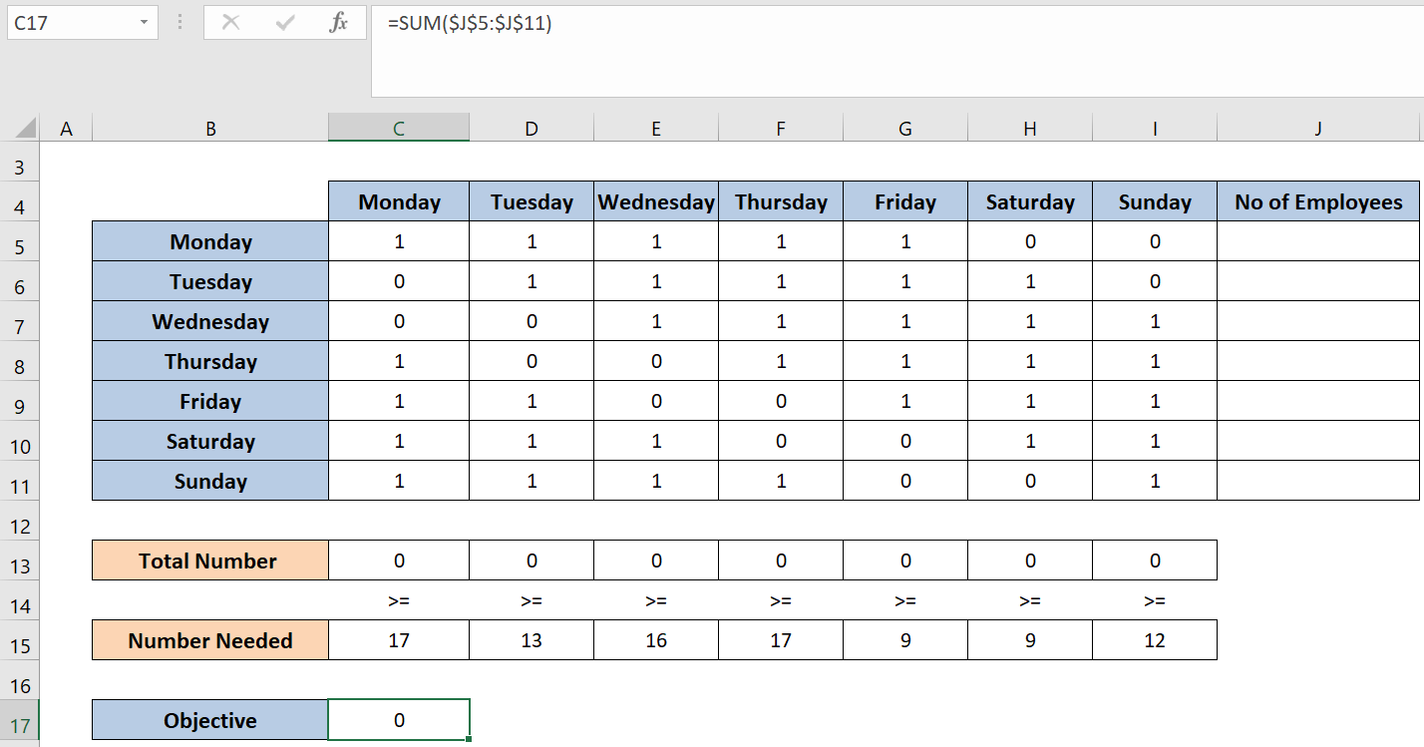
PS Example II Solver Step-1

Slide 15
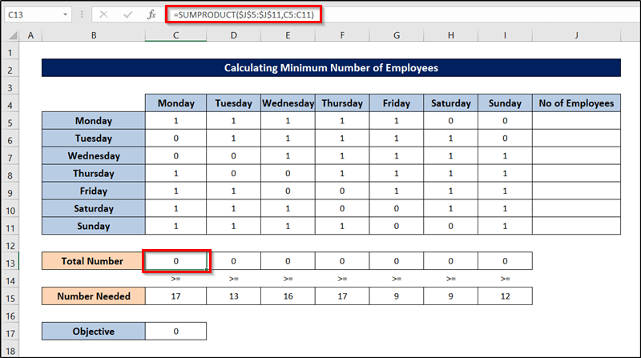
PS Example II Solver Step-2

Slide 16
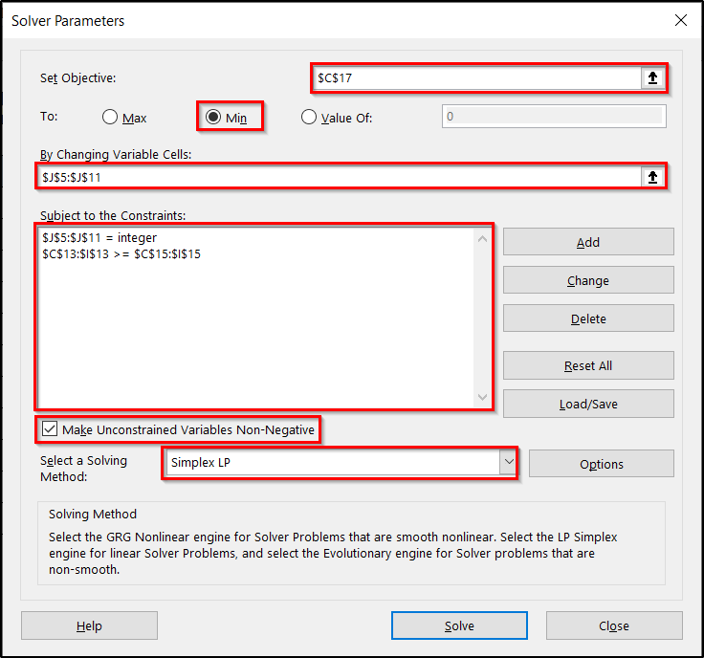
PS Example II Solver Step-last

Slide 17

PS Example II Optimal Solution

Slide 18
Production Scheduling (PS) Example # III
Table shows the number of workers needed for a bank is shown in cells from C15 through I15. For example, 17 workers are needed on Monday, 13 workers are needed on Tuesday, 15 workers are needed on Wednesday, and so on. All bank employees work five consecutive days. Suppose those employees in the same bank (in case 2) are paid $150 per day for the first five days and they work a day of overtime at a cost of $350. How should the bank schedule its employees?

Slide 19
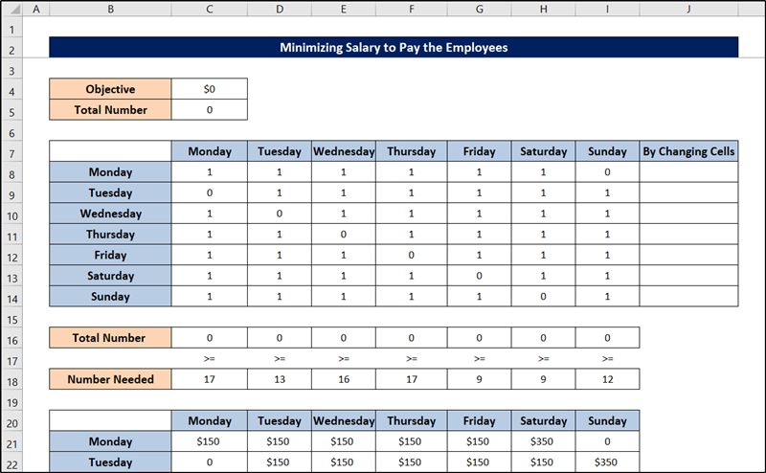
Production Scheduling (PS) Example # III
Generally, there are two parts to the dataset. The range C8:I14 provides information that can be used to compute constraints while the range C21:I27 offers information for calculating how much the bank should pay its employees. Constraints, in this case, are the same as those in case II. And like case II, we have prepared the sheet using the SUM and SUMPRODUCT functions.

Slide 20
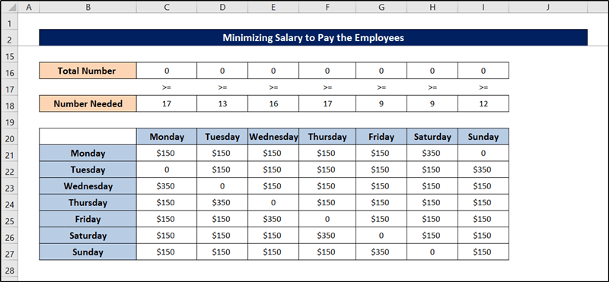
PS Example III Solver Step-1

Slide 21
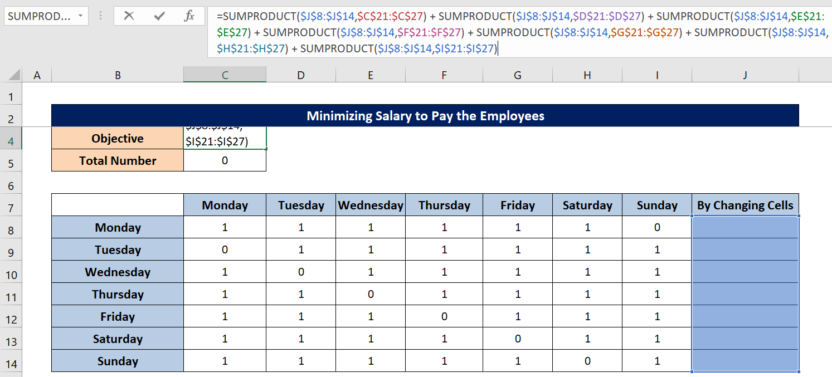
PS Example III Solver Step-2

Slide 22
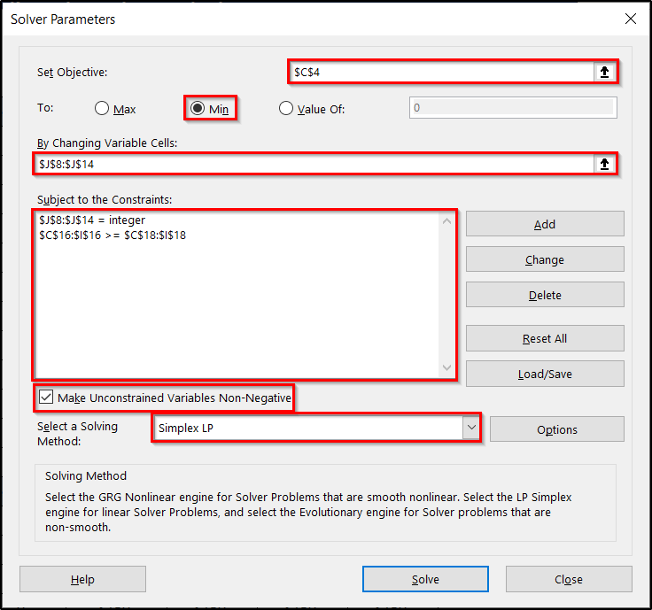
PS Example III Solver Step-last

Slide 23
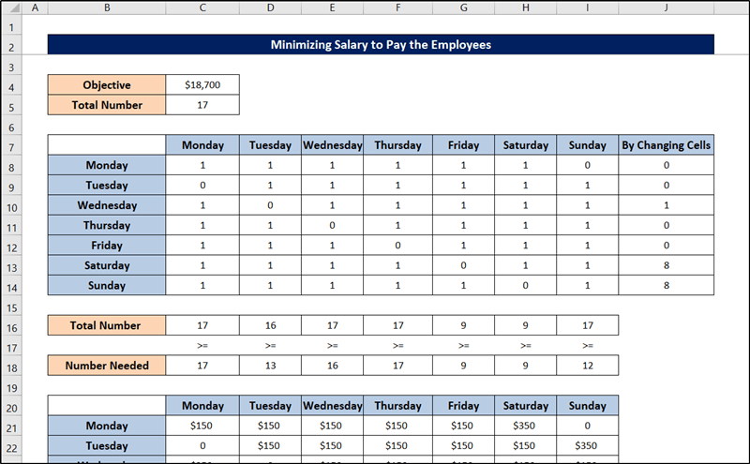
PS Example III Optimal Solution

Slide 24
Production Scheduling (PS) Example # IV
Table shows the number of workers needed for a bank is shown in cells from C15 through I15. For example, 17 workers are needed on Monday, 13 workers are needed on Tuesday, 15 workers are needed on Wednesday, and so on. All bank employees work five consecutive days. Suppose that the bank has 22 employees. How should the workers be scheduled so that they would have the maximum number of weekend days off?

Slide 25
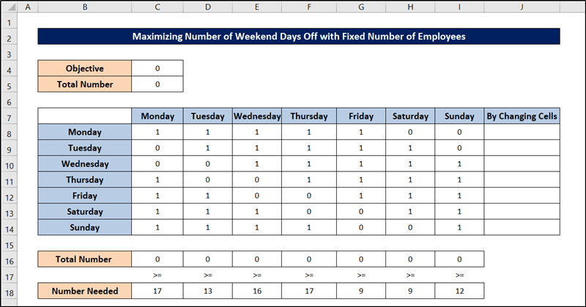
Production Scheduling (PS) Example # IV
Generally, there are two parts to the dataset. The range C8:I14 provides information that can be used to compute constraints while the range C21:I27 offers information for calculating how much the bank should pay its employees. Constraints, in this case, are the same as those in case II. And like case II, we have prepared the sheet using the SUM and SUMPRODUCT functions.

Slide 26
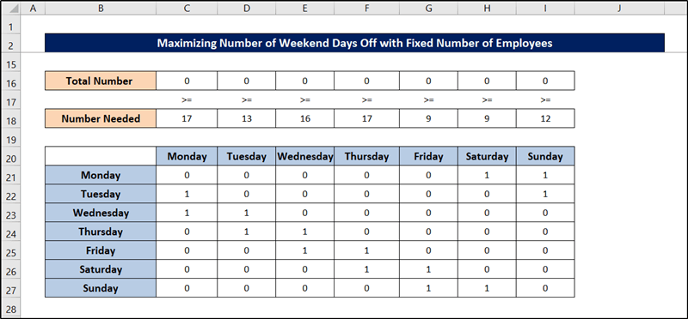
PS Example IV Solver Step-1

Slide 27
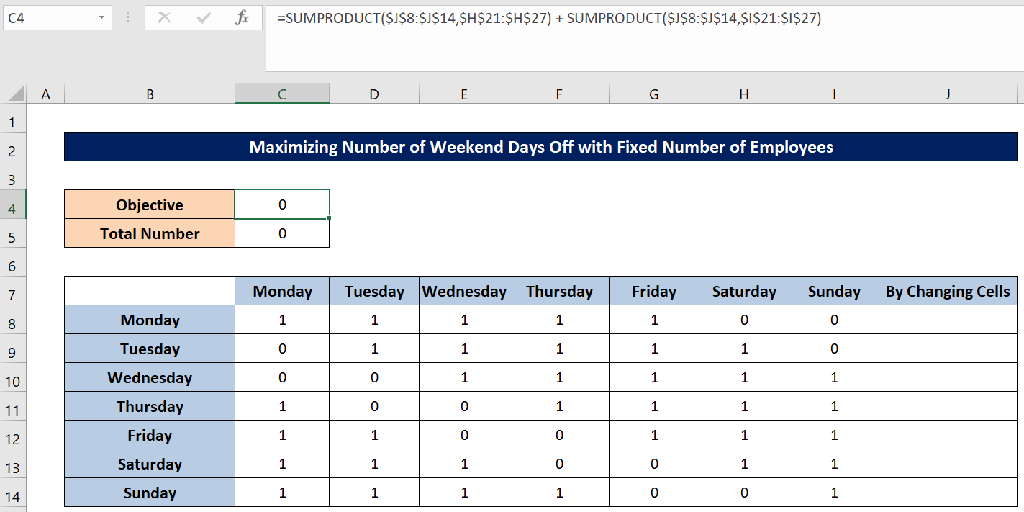
PS Example IV Solver Step-2

Slide 28
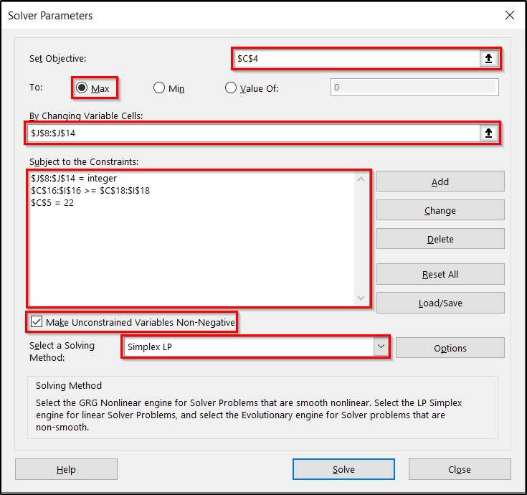
PS Example IV Solver Step-last

Slide 29
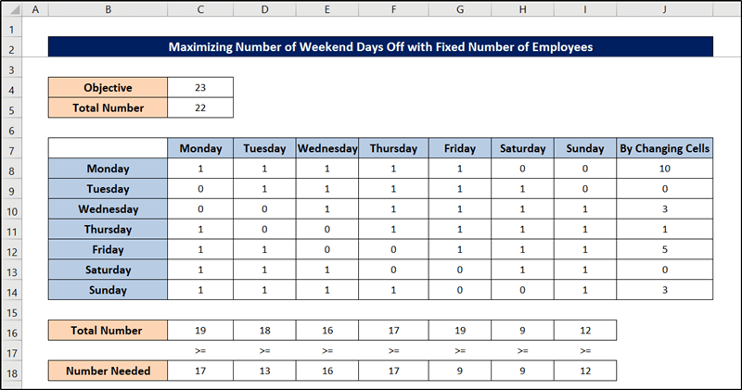
PS Example IV Optimal Solution

Slide 30
Linear Programming Problems
Product Mix Problem
Blending Problem
Production Scheduling Problem
Transportation Problem
Flow Capacity Problem

